Slide 1
GOVERNMENT OPENNESS RATING 2.0

Slide 2
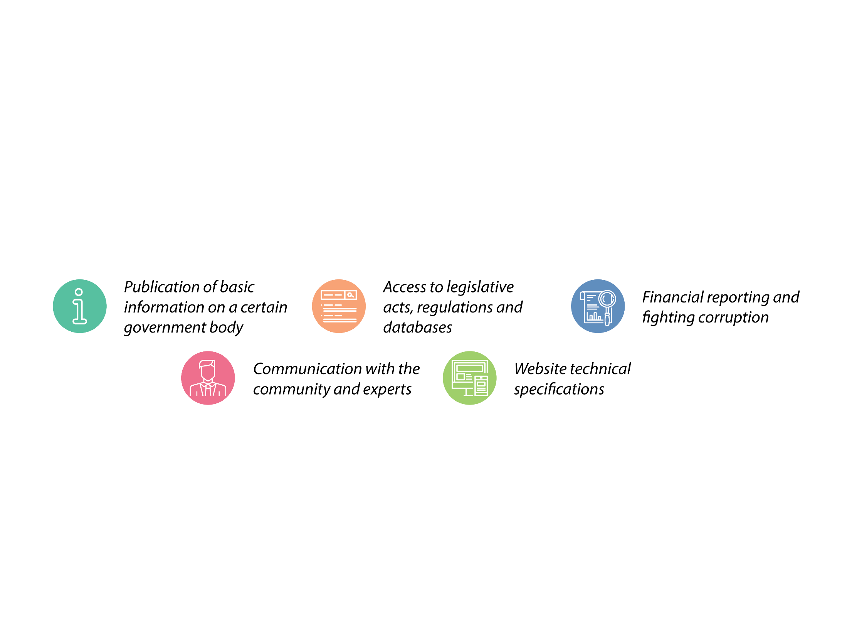
RATING CRITERIA

Slide 3
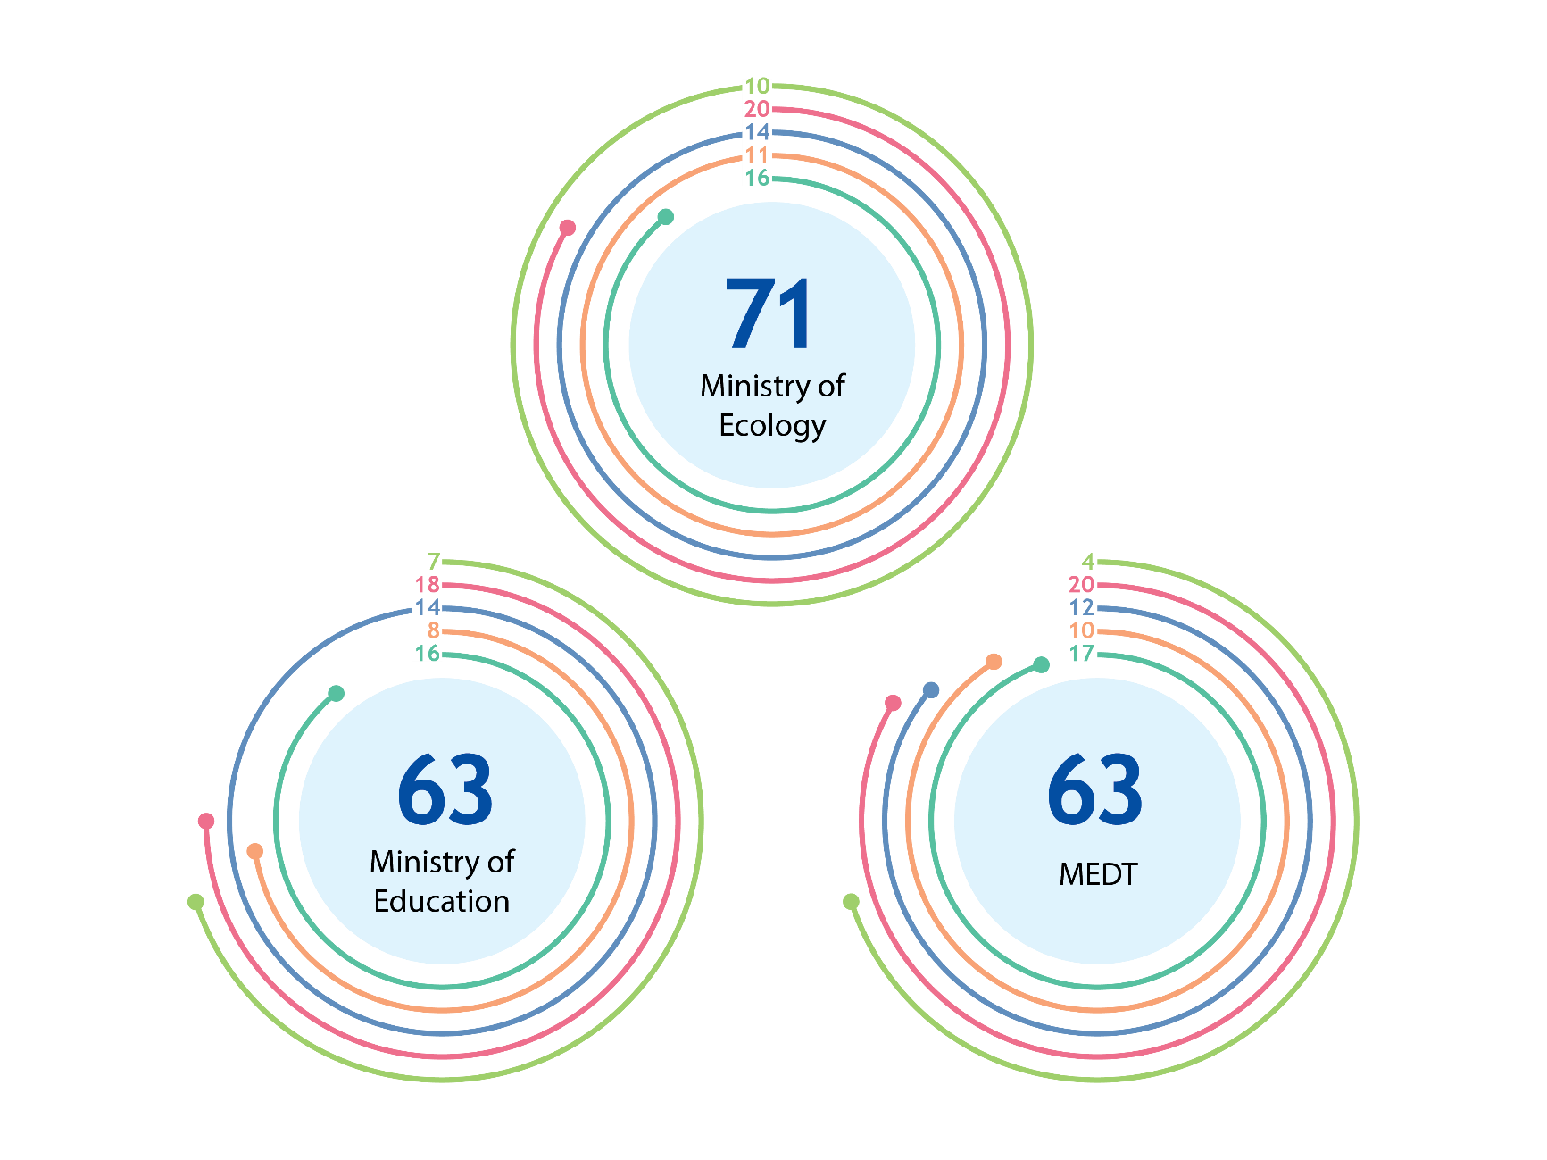
LEADING MINISTRIES

Slide 4
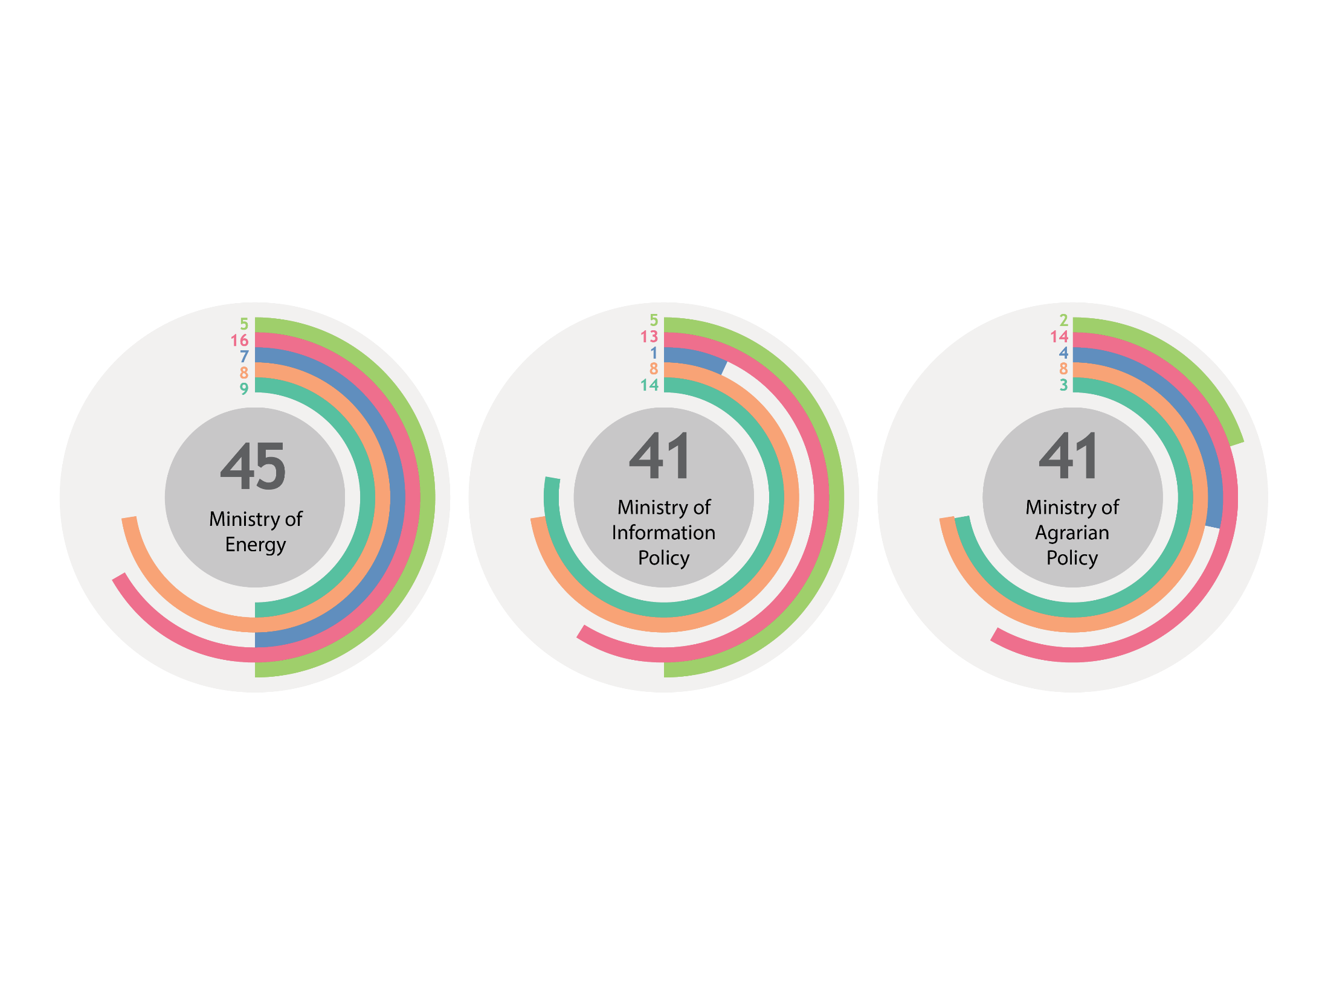
OUTSIDER MINISTRIES

Slide 5
DYNAMICS OF MINISTRIES OVER THE PAST YEAR
MINISTRY | RATING POSITION | DYNAMICS
Ministry of Ecology | 1 | +12
Ministry of Education | 2-3 | -
МEDT | 2-3 | +5
Ministry of Justice | 4 | +5
Ministry of Regional Development | 5 | -1
Ministry of Infrastructure | 6 | -5
MIA | 7-8 | +9
Ministry of Helthcare | 7-8 | -1
MFA | 9 | +8

Slide 6
DYNAMICS OF MINISTRIES OVER THE PAST YEAR
MINISTRY | RATING PLACE | DYNAMICS
Міністерство фінансів | 10 | -7
Міністерство оборони | 11 | +3
Міністерство молоді та спорту | 12 | -5
Міністерство соціальної політики | 13-15 | -1
Міністерство культури | 13-15 | -9
Міністерство з питань тимчасово окупованих територій | 13-15 | +3
Міністерство енергетики | 16 | -5
Міністерство інформполітики | 17-18 | -
МінАгро | 17-18 | -3

Slide 7
OTHER GOVERNMENT BODIES
POSITION | AGENCY
1 | State Emergency Service of Ukraine
2 | Pension Fund of Ukraine
3 | State Agency of Water Resources of Ukraine
….. | …………
41-42 | State Agency of Reserve of Ukraine
41-42 | State Inspectorate on Energy Supervision of Ukraine
43 | Ukrainian Institute of National Remembrance

Slide 8
IMPLEMENTATION OF RECOMMENDATIONS OF THE GOVERNMENT OPENNESS STUDY
were not implemented
75
54
25
fully implemented
of them were implemented partially
According to the spring study’s results, we provided ministries with 154 recommendations:

Slide 9
WE RECOMMEND ALL GOVERNMENT BODIES TO PUBLISH THE FOLLOWING INFORMATION ON THEIR WEBSITES REGULARLY:
updated information on activity plans for the current year;
reports on activities carried out last year;
updated information on their budget for the current year;
updated information on financial reports for the previous year;
information on action plans of public councils for the current year;
reports on their activities for the previous year;
information on plans of public consultations for the current year;
reports on public consultations for the current year;
providing an adaptive website design for effective use on mobile devices and tablets;
providing website versions for visually impaired people;
providing advanced websites search options;
providing the option of automated electronic forms for sending citizen requests to the bodies;
providing administrative services through the Internet

